Slide 1

Introduction to Computer Science
Day 3

Slide 2
Chapter 9
Introduction to High-Level Language Programming

Slide 3
The Language Progression
Assembly language improves on machine language
Assembly language disadvantages
Programmer must manage movement of data among memory locations and registers
Microscopic view of the task
Machine specific languages
Far from natural language
Example: The following ASSEMBLY language instruction stores the value of 97 in memory:
MOV AL, 61h

Slide 4
The Language Progression (cont'd.)
High-level programming languages improve on assembly language
Expectations
Programmer need not manage data in memory
Macroscopic view of tasks (e.g., “add B and C”)
Programs are portable from one machine to another
Program statements are closer to natural language and math notation
Third-generation languages: C++, Java, C# etc.

Slide 5
The Language Progression (cont'd.)
Need a translator for high level languages
Compiler converts source code to assembly code or similar
Assembler or other converter makes object code
Code libraries contain object code for useful tools
Linker integrates multiple files of object code to create an executable module

Slide 6
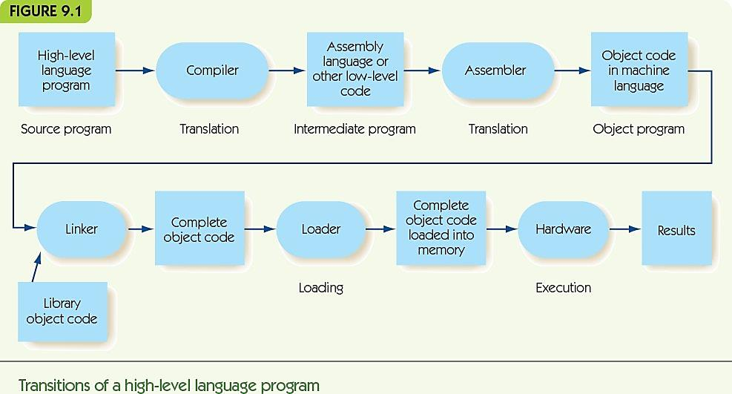

Slide 7
Programming Examples
Examine similarities and differences of the languages (Ada, C++, C#, Java, and Python) through examples
Favorite Number
Ask user for her favorite number and then tell her that your favorite number is one greater than hers

Slide 8
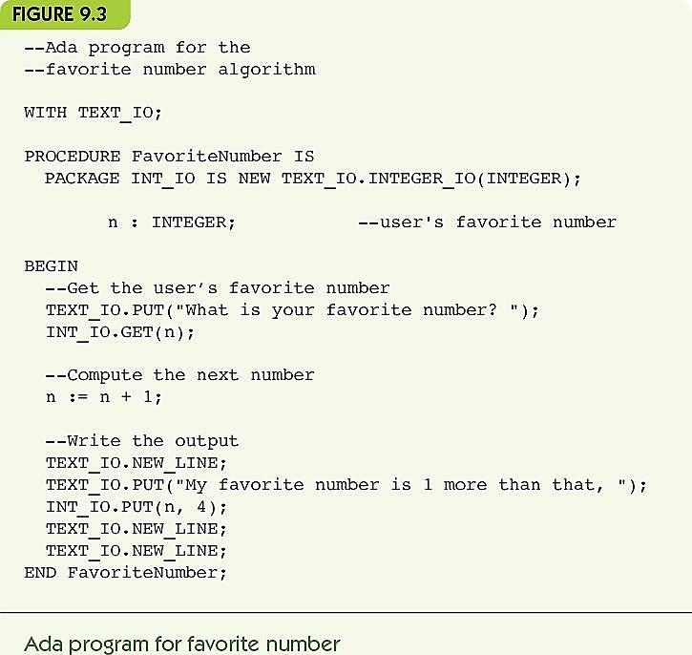
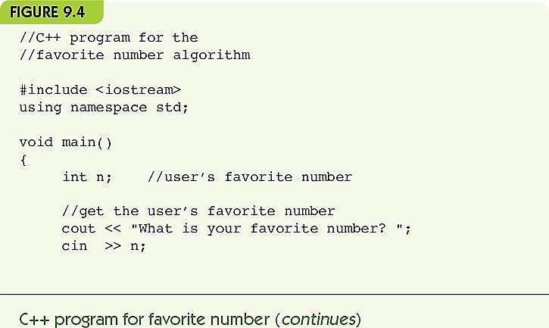
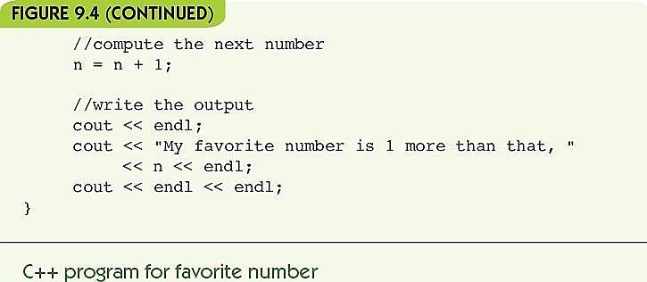

Slide 9
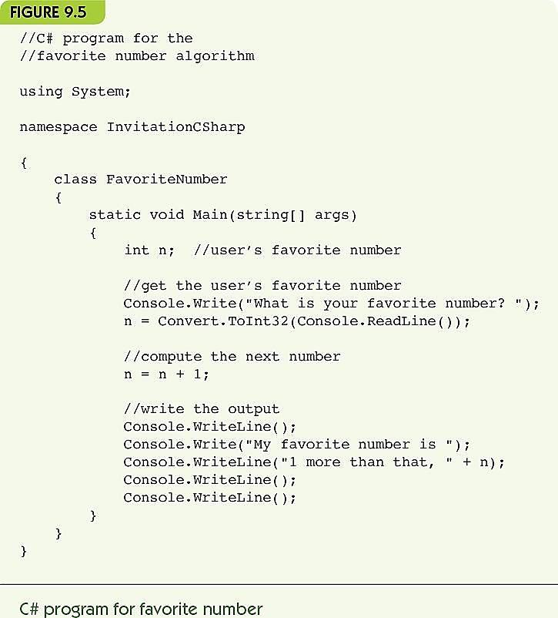
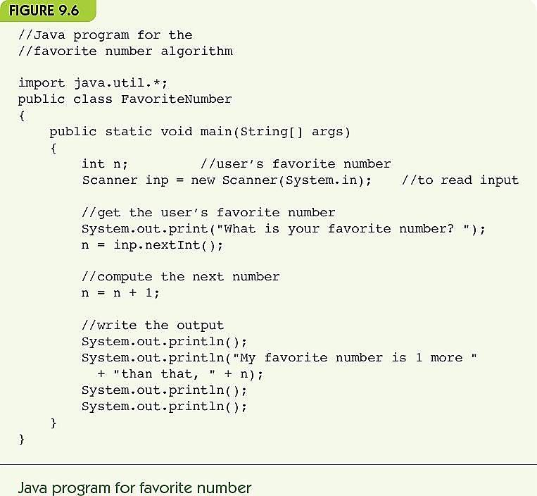

Slide 10
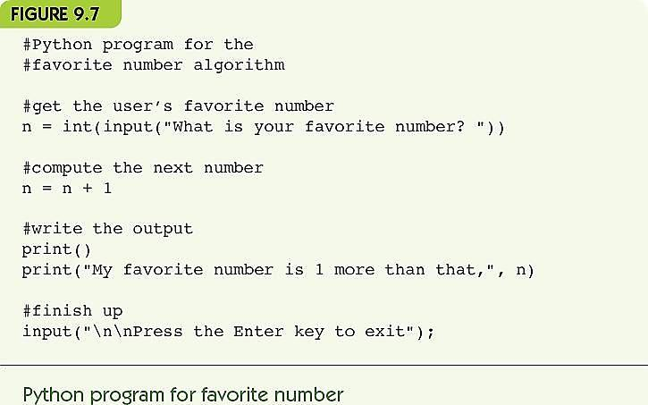

Slide 11
Meeting Expectations
Programmer need not manage data in memory
In each language, programmers must declare names (and sometimes types) for variables
Program manages movement of data associated with a given variable name
Macroscopic view of tasks (e.g., “add B and C”)
Languages provide statements for high-level math
Details of complex operations, such as conditional statements and loops are hidden

Slide 12
Meeting Expectations (cont'd.)
Programs are portable from one machine to another
Programming languages standardized
Compiled languages (Ada, C++, Java, and C#)
Compilers written for a particular platform support standard, and translate to machine-specific forms
Programmers distribute executable or low level “bytecode”, not source
Interpreted languages (like Python) require an interpreter on each machine and distribute source code
Program statements are closer to natural language and math notation
Math notation fairly standard across languages
Conditionals and loops closer to natural language than assembly

Slide 13
Summary
High-level languages:
Hide details of memory and hardware operations
Enable code portability
Shift code statements toward natural language and math notation
Programming languages may share an underlying philosophy, but vary in syntax and semantics details
Ada, C++, C#, Java, and Python are all third generation languages (in this program you will learn Java and Python).

Slide 14
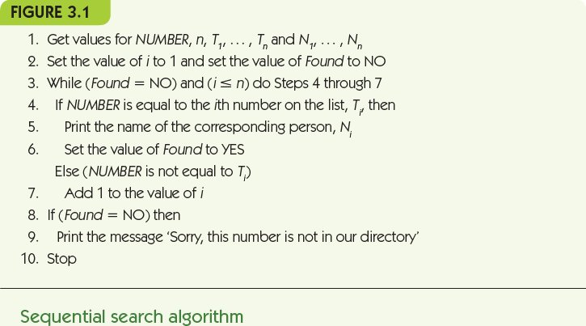
Exercise
Write a program (on paper or in a text editor) to implement the sequential phone number search algorithm:

Slide 15
Chapter 10
The Tower of Babel

Slide 16
Why Babel?
Why isn’t there just one high-level programming language?
Why isn’t there just one model of automobile?
Each language has tasks it performs well
Complex computations on real numbers
Detailed page layout
Database interactions
Choose a language based on the tasks to be done
Choose a language based on its approach to computation (its philosophy)

Slide 17
Procedural Languages
Procedural language philosophy
Tell the computer step by step how to manipulate variables (data in memory locations)
Programs are broken into modules to handle separate tasks
Think of similarities between French, Spanish, English and Italian – they are all part of Romance languages.

Slide 18
Procedural Languages FORTRAN (cont'd.)
FORmula TRANslation
Developed at IBM in the 1950s by John Backus
First high-level language actually implemented
Focus on numerical computation
Control structures similar to assembly language
GO TO
Like a JUMP
Can create spaghetti code
External libraries: tested special-purpose code

Slide 19
Procedural Languages COBOL (cont'd.)
COmmon Business-Oriented Language
Developed by the U.S. Navy in 1959 by Admiral Grace Murray Hopper
Focus on business applications
Inventory or payroll
Master file updated by transaction files: file I/O key
Wide use in legacy code (60% of existing code)
Year 2000 (Y2K) issues
Required massive updating of old COBOL

Slide 20
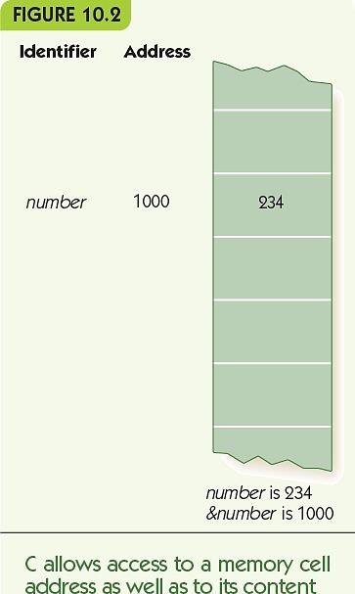
Procedural Languages C/C++ (cont'd.)
1970s: C developed at AT&T Labs by Dennis Ritchie
Focuses on system programming
Close connection to UNIX
Highly efficient
High level constructs as desired
Low-level constructs when efficiency is needed
Access to variable’s value and its location
number refers to its value
&number refers to its memory location
Pointer data type contains memory locations

Slide 21
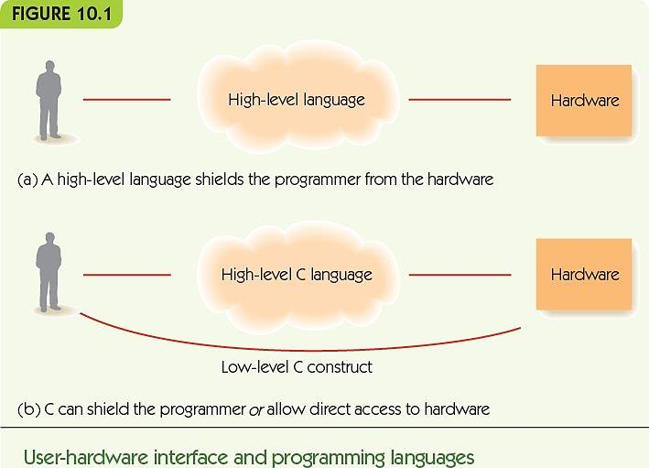

Slide 22
Procedural Languages C/C++ (cont'd.)
C specialty: system programming
Example: device drivers
Ability to interact with low-level hardware
1980s: C++ was developed at AT&T Labs by Bjarne Stroustrup
C++ is a superset of C
Object-oriented programming
Collections of code libraries

Slide 23
Procedural Languages Ada (cont'd.)
1970s: Ada was developed by the US military
Specialties
Multiprocessing
Strong object-oriented
Safety and reliability
Used heavily by:
Defense Department
Transportation industry
Financial industry
Communications industry

Slide 24
Procedural Languages Java (cont'd.)
Developed by Sun Microsystems in the early 1990s
Designed for:
Platform independence
Reliability
Security
Graphical user interfaces
Strong integration with web browsers
Object-oriented, like C++

Slide 25
Procedural Languages Java (cont'd.)
Java programs may be:
Applications: stand-alone software
Applets: software that runs through a webpage
Portability is a key strength
Applications and applets run on most platforms and through most browsers
Source code compiles to platform-independent bytecode (generic low-level code)
Java bytecode interpreter translates to host machine (small program, integrated into browsers)
Java rights now are currently owned by Oracle Corp.

Slide 26
Procedural Languages Python (cont'd.)
Developed by Guido van Rossum in early 1990s
Open source: source code for Python is freely available and anyone may suggest changes
Language evolution is now guided by the Python Software Foundation
Developed for system administrator tasks and web interfaces
Interpreted: source code is translated when executed
Relaxed syntax, easy to use, extensive libraries

Slide 27
Procedural Languages C# and .NET (cont'd.)
C#:
Developed by Microsoft in 2000
Successor to C++, but not a superset
Similar to Java in form and goals
Security
Reliability
Integrated into the .NET framework
Microsoft support framework for many languages
Large collection of code libraries and tools

Slide 28
Procedural Languages C# and .NET (cont'd.)
.NET:
Garbage collection: reclaiming memory for reuse
All .NET languages compile to Microsoft Intermediate Language (MSIL)
MSIL code is compiled by a just-in-time (JIT) compiler, small program that produces platform-specific object code
.NET languages include: Ada, COBOL, C++, C#, and Visual Basic

Slide 29
Special-Purpose Languages
Languages designed for one specific purpose, not general-purpose programming languages
SQL, Structured Query Language
Ask questions about data in a database
HTML (HyperText Markup Language)
Describes the formatting of webpages
Javascript
Lightweight scripting language for active webpages
Code is embedded in the HTML for the page
You will learn HTML, JavaScript and SQL in this program.

Slide 30
Special-Purpose Languages (cont'd.)
SQL was developed by IBM in 1986
Databases store data
A query describes what information the user wants, not how to find it
Example: Find all names of vendors with whom we do more than $40,000 worth of business
SELECT NAME
FROM VENDOR
WHERE PURCHASE > 40000

Slide 31
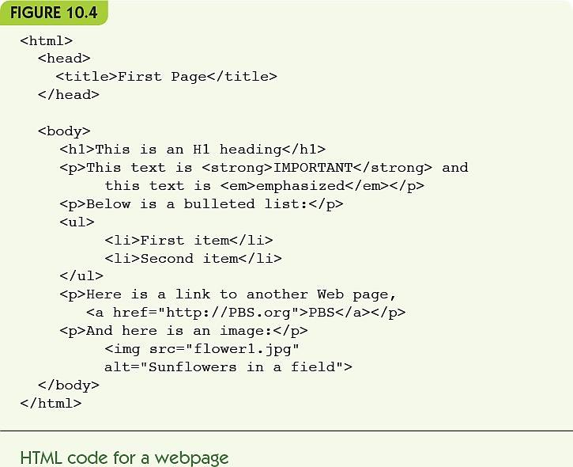
Special-Purpose Languages (cont'd.)
HTML contains text to be displayed and tags
Tags describe:
Formatting of text
Special effects
Links to other webpages
Tags come in pairs - start and end
Tags are written with angle brackets:
<title> and </title>
<em> and </em>

Slide 32
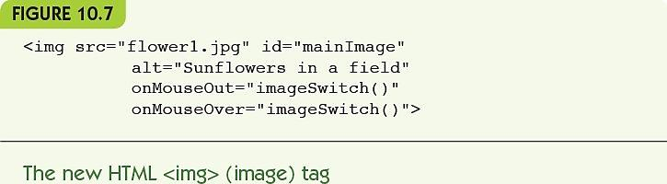
Special-Purpose Languages (cont'd.)
Javascript code is embedded in HTML
Enables webpages to react to users
Scripting language
Interpreted
Lightweight (reduced features)
Example:
Change image when mouse moves over it
Event handler: a function that responds to an event like mouse movement, button clicks, etc.

Slide 33
Alternative Programming Paradigms
Paradigm: model or mental framework for thinking about something
Procedural programming paradigm
A program is a sequence of detailed instructions, accessing and modifying memory locations
Functional programming paradigm
A program is a series of transformation on items

Slide 34
Alternative Programming Paradigms (cont'd.)
Logic programming paradigm
A program is a series of logical deductions from known facts
Parallel programming paradigm
A program is made up of:
Multiple copies of the same subtask OR
Multiple subtasks of the same problem
Performed simultaneously by different processors

Slide 35
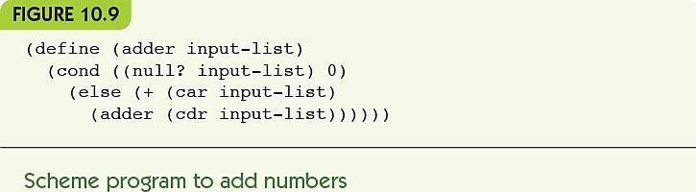
Alternative Programming Paradigms Functional Programming (cont'd.)
1958: LISP was developed at MIT by John McCarthy
Scheme is a variant of LISP developed in 1970s
Functional programming language
Organized around functions
A function takes inputs and produces a single value
Define functions
Call, or apply, functions
Combine function calls
Applicative languages

Slide 36
Alternative Programming Paradigms Logic Programming (cont'd.)
Logic programming languages
Programs describe rules and facts, not how to do something
Queries use logical deduction to produce outputs that follow from the rules and facts given
Declarative languages
Programs declare what is true
Artificial intelligence applications
Expert systems solve problems with logical reasoning

Slide 37
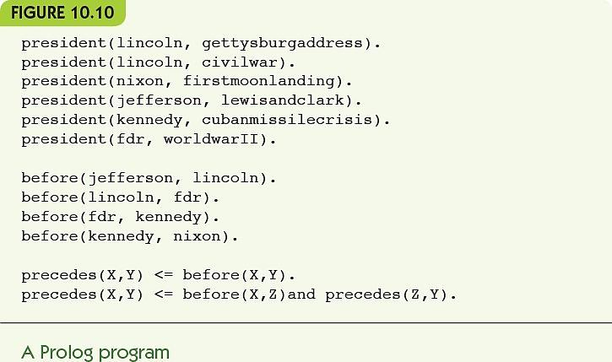
Alternative Programming Paradigms Logic Programming (cont'd.)
1972: Prolog was developed at the U. of Marseilles by A. Colmeraur
Facts describe relationships among specific objects
president(nixon, vietnam_war).
Rules describe general relationships using variables
precedes(X, Y) :- before(X, Y).
X precedes Y if X came before Y
precedes(X, Y) :- before(X, Z), precedes(Z, Y).
X precedes Y if X came before Z and Z precedes Y.

Slide 38
New Languages Keep Coming
2009: Go was developed at Google by Ken Thompson
Combines ease of programming with safety
Supports networked and multicore computing
Fast compilation, Open source
F# was developed at Microsoft in 2005
Functional, with some object-oriented and parallel
Supported by .NET
Swift: new Apple language for building apps in iOS and OS X

Slide 39
Conclusion
Languages vary by:
Philosophy
Intended application areas
Strengths and purposes
Style, syntax, semantics
Approaches to types, variables, memory
Tools provided or accessible
Languages cross paradigms

Slide 40
Summary
Many programming languages exist because they reflect different intended uses or different philosophical views
Procedural programming languages include:
Plankalkül, FORTRAN, COBOL, C/C++, Ada, Java, Python, and C#
Special-purpose programming languages have limited range of use: SQL, HTML, Javascript
Other paradigms include:
Functional, logic, and parallel programming

Slide 41
Summary (cont'd.)
Functional programming languages organize programs around functions, function calls, and combining of functions
Logic programming languages do not specify how to do something, but give facts and rules and let the program deduce the results
New programming languages evolve continuously for new or evolving purposes

Slide 42
Exercises
Exponentation is expressed in Fortran by **; that is, 3**2 means 3 in the power of 2. If i has the value 7 and j has the value 3, what is the value of the following Fortran expression?
((i-j)**2)/2
What is the value of RESULT after execution of the following COBOL code if VALUE1 has the value of 100?
MOVE VALUE1 to VALUE2.
ADD 1 to VALUE2.
ADD VALUE1 to VALUE2.
ADD VALUE1 to VALUE2 GIVING RESULT.
Code fragments of what language can be embedded in web pages to make those pages active rather than static?
What language is used to frame database queries?
What language was designed for building apps on the iOS and OS X operating systems?

Slide 43
Chapter 11
Compilers and Language Translation

Slide 44
Introduction
High-level languages must be translated into machine instructions
Compilers do the translation
Compiler-writing is difficult and complex
Compilers must be:
Correct ► machine instructions must do exactly what the high-level instructions mean
Efficient and concise ► code produced should be optimized and run fast

Slide 45
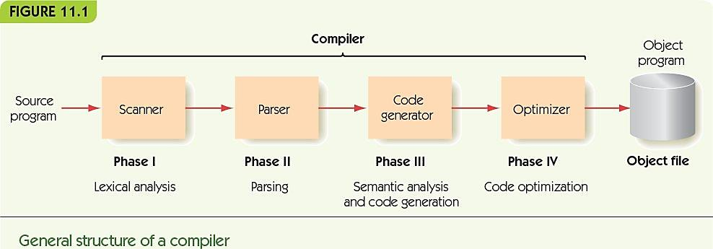
The Compilation Process
Four phases of compilation
Phase I: lexical analysis
Groups characters into tokens (equivalent to words)
Phase II: parsing
Checks grammatical structure and builds internal representation of program
Phase III: semantic analysis and code generation
Analyzes meaning; generates machine instructions
Phase IV: code optimization
Improves efficiency of code in time or space required

Slide 46
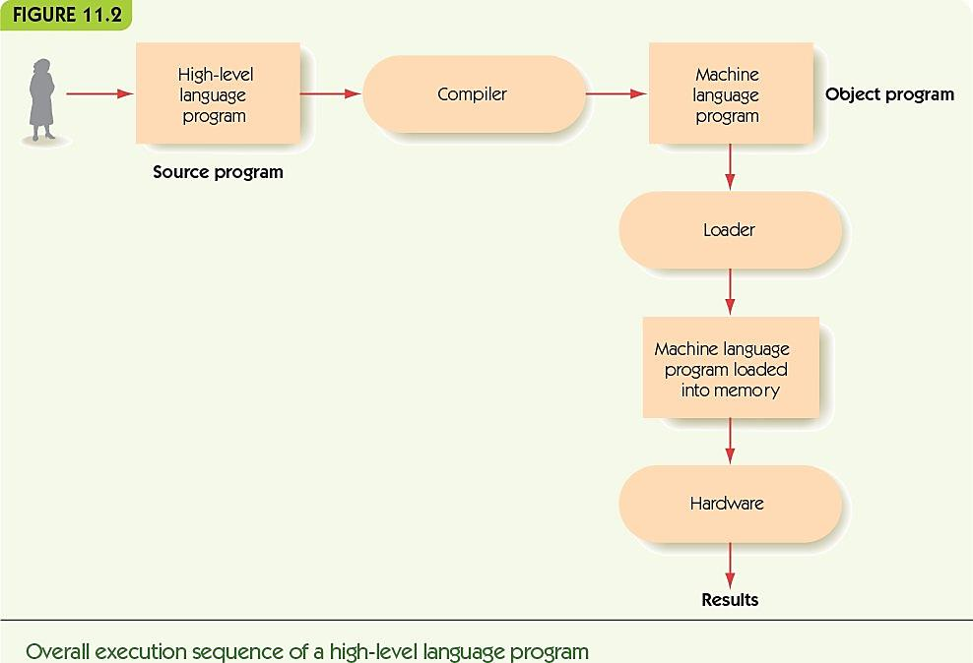

Slide 47
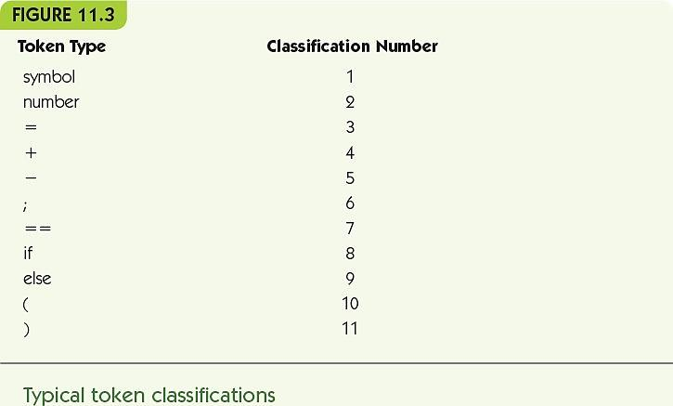
The Compilation Process Phase I: Lexical Analysis (cont'd.)
A lexical analyzer or scanner
Groups input characters into tokens
Discards unneeded characters
Examples: blanks, tabs, and comment text
Determines the type of each token
Examples: symbol, number, and left parenthesis
Tokens are words and punctuation
Meaningful to the language

Slide 48
The Compilation Process Phase II: Parsing (cont'd.)
A parser takes a list of tokens and:
Determines grammatical structure
Diagrams the program, building a parse tree
Syntax = grammatical structure
Syntax is defined by rules (productions)
BNF (Backus-Naur Form) is notation for describing rules
A grammar is the set of rules that define a language

Slide 49
The Compilation Process Phase II: Parsing (cont'd.)
BNF
Rules
left-hand side ::= right-hand side
<sentence> ::= <subject> <verb> <object>
Left-hand side: grammatical category
Right-hand side: pattern that captures the structure of category
<addition operator ::= +
<assignment operator> ::= <symbol> = <expression>

Slide 50
The Compilation Process Phase II: Parsing (cont'd.)
“If, by repeated applications of the rules of the grammar, a parser can convert the sequence of input tokens into the goal symbol, then that sequence of tokens is a syntactically valid statement of the language. If it cannot convert the input tokens into the goal symbol, then this is not a syntactically valid statement of the language.”

Slide 51
The Compilation Process Phase II: Parsing (cont'd.)
Parsing example: x = y + z
Apply <variable> ::= … rules
<variable> = <variable> + <variable>
Apply <expression> ::= <variable> + <variable> rule
<variable> = <expression>
Apply <assignment statement> rule
<assignment statement>

Slide 52
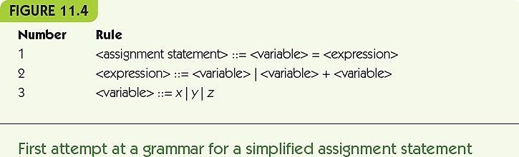
The Compilation Process Phase II: Parsing (cont'd.)

Slide 53
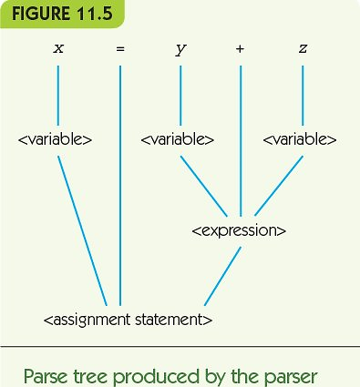
The Compilation Process Phase II: Parsing (cont'd.)

Slide 54
The Compilation Process Phase II: Parsing (cont'd.)
Look-ahead parsing algorithms
Look at future tokens to choose the right rule to apply
Allows for arbitrary-length patterns
x = x + y + z + q + p
Recursive definition: definition includes left-hand term on the right-hand side
<expression> ::= <expression> + <expression>

Slide 55
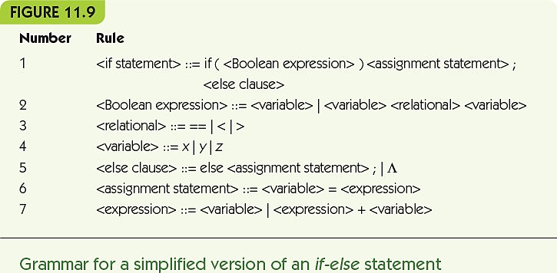
The Compilation Process Phase II: Parsing (cont'd.)

Slide 56
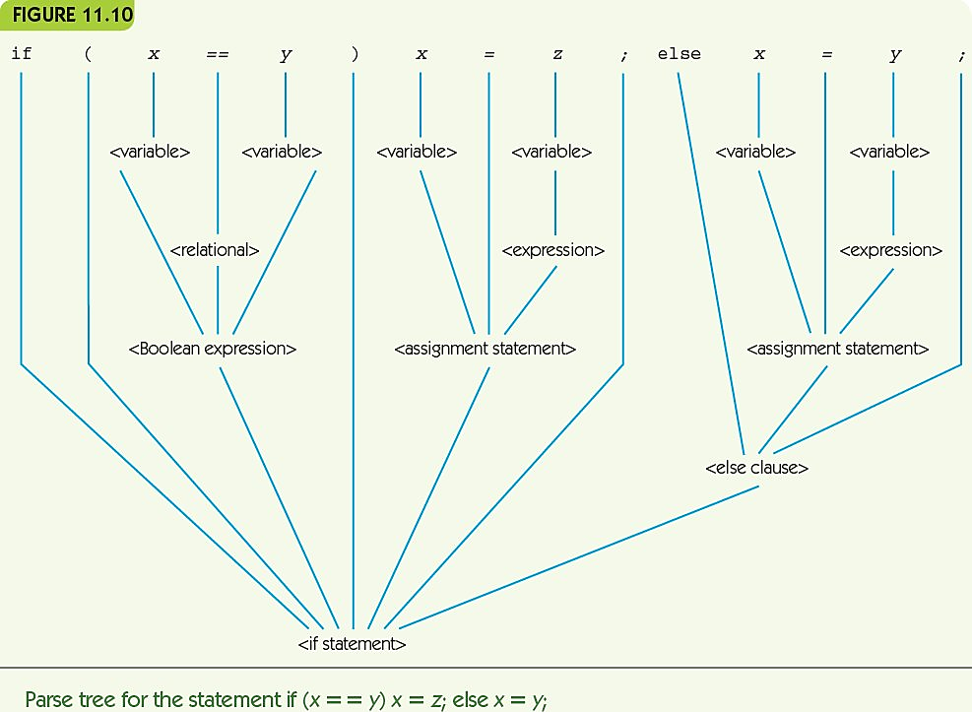

Slide 57
The Compilation Process Phase III: Semantics and Code Generation
Semantic analysis
Checks that parse tree all makes sense
Grammatical statements can be meaningless
Example: bees bark
Semantic records
Store information about actual values associated with nonterminals
<variable> came from a token “x” and its type was integer

Slide 58
The Compilation Process Phase III: Semantics and Code Generation (cont'd.)
Code generation
Translates parse tree pieces to assembly code
Can build semantic records as it goes
Semantic analysis is simultaneous with generation
Not all parts of the parse tree produce code

Slide 59
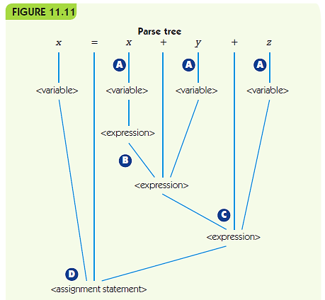
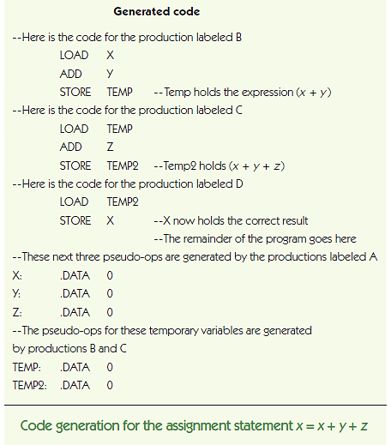

Slide 60
The Compilation Process Phase IV: Code Optimization
Code optimization
Improving the time or space efficiency of code produced by a compiler
Early days: “Hardware is expensive, programmers are cheap”
Humans could write more optimal code than a compiler
These days: “Hardware is cheap, programmers are expensive”
Modern compilers optimize, but focus on other issues
Visual development environments help programmers see what is happening
Online debuggers help find and correct bugs
Reusable code libraries and toolkits

Slide 61
The Compilation Process Phase IV: Code Optimization (cont'd.)
Local optimization
Examines small chunks of assembly code (< 5 instructions)
Constant evaluation computes arithmetic expressions at compile-time if possible
Strength reduction, uses faster arithmetic alternatives (e.g., 2 * x is equivalent to x + x)
Eliminating unnecessary operations removes operations that are unneeded, like a LOAD of a value already in memory

Slide 62
The Compilation Process Phase IV: Code Optimization (cont'd.)
Global optimization
Looks at large segments of the program
Blocks like while loops, if statements, and procedures
Much more difficult, much bigger effect!
Optimization cannot overcome an inefficient algorithm

Slide 63
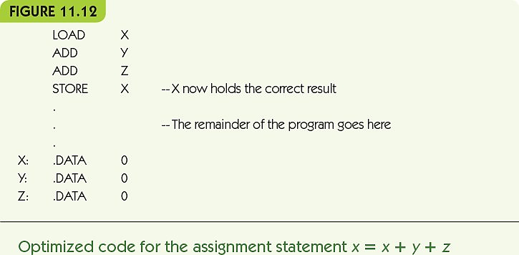
The Compilation Process Phase IV: Code Optimization (cont'd.)

Slide 64
Summary
High-level languages require compilers to translate programs into assembly language
Compilation is much more difficult and complex than assemblers translating assembly to machine instructions
Compiler phases include: lexical analysis, parsing, semantic analysis, code generation, and code optimization
Lexical analysis converts a text of characters into a list of tokens

Slide 65
Summary (cont'd.)
Parsing is based on a formal grammar specifying the rules for a language
Parsers check grammaticality and build parse trees
Semantic analysis checks parse trees for meaning: determines whether code can meaningfully be generated
Code generation produces assembly instructions from the parse tree
Code optimization looks for opportunities to make generated code better

Slide 66
Exercises
Describe the four phases of compilation.
Create a parse tree for the assignment statement
x = x + y
What does this BNF rule say?
<addition operator> ::= +
Describe the purpose of debuggers.

